Slide 1


Thesis and TDK (Scientific Students’ Conference) Information Session
2026/27/1
Keleti Faculty of Business and Management
21 September 2026

Slide 2
Participants from the Faculty’s Advisory Team for International Students
Dr. habil. Csilla Mizser
Associate Professor and Mentor for International Students
Department of Economics, Finance and Accounting
mizser.csilla@kgk.uni-obuda.hu
Dr. Réka Saáry
Assistant Professor and Mentor for International Students
Department of Marketing, Management and Methodology
saary.reka@kgk.uni-obuda.hu
Dr. Zsuzsanna Balázs
Assistant Professor
Faculty Academic Advisor for International Students
Department of Business Sciences and Digital Skills
balazs.zsuzsanna@kgk.uni-obuda.hu
Ágota Cseri
Representative of the Study Department
cseri.agota@kgk.uni-obuda.hu
Andrea Kozma-Loraszkó
Faculty International Coordinator
loraszko.andrea@kgk.uni-obuda.hu

Slide 3
Agenda
Important Deadlines and Dates
Thesis Writing
Scientific Students’ Conference (TDK)
Useful Links
Q & A

Slide 4
Important Deadlines and Dates
15 december 2026: deadline for thesis submission
This applies both to the electronic and the hardbound (print) copy of your thesis.
The electronic (PDF) copy must be submitted via the Thesis Submission Portal (https://diploma.uni-obuda.hu/ )
Please do not leave any revisions for the day of submission, aim to submit your work some days prior to the deadline.
You can only submit with your thesis supervisor’s approval!
After your thesis is submitted, it is sent to the Library for plagiarism check.
64th SCIENTIFIC STUDENTS’ CONFERENCE (TDK) DEADLINES:
21 OCTOBER 2026, 12.00 (Central European Time): application deadline, including submission of paper title and abstract via the submission portal (https://tdk.kgk.uni-obuda.hu/).
11 NOVEMBER APRIL 2026, 12.00 (Central European Time): submission deadline for the final paper to be uploaded to the submission portal (https://tdk.kgk.uni-obuda.hu/).
18 NOVEMBER 2026, from 14.00 (Central European Time): 10-minute presentation of your paper in front of a committee and Q&A.
2 DECEMBER 2026, 17.00 (Central European Time): Award ceremony (Bécsi út 96/B, Aud. Max.)

Slide 5
Aim of the Thesis/Diploma Work
The general regulation regarding the thesis/diploma thesis is contained in § 55 of the TVSZ (Education and Exam Regulations).
(2) The purpose of preparing the thesis/diploma work is for the student to independently solve a complex task – appropriate to the nature of the major – at the end of his/her studies, thereby proving that he/she has professional knowledge and skills that meet the requirements set out in the training objectives, and that he/she is knowledgeable in the literature. The thesis/diploma assignment gives the student the opportunity for independent creative activity, as well as to present his knowledge of the essential connections between certain parts of his/her field of expertise, as well as the practical technical and economic requirements related to them.
(3) In order to obtain the diploma, the student must prepare a thesis for the bachelor's degree, and a diploma thesis for the master's degree and undivided degree.

Slide 6
Thesis Writing – The Process
Choosing a topic and a supervisor via Neptun.
Registering for the Thesis subject via Neptun.
Writing the thesis (while meeting the deadlines given by your supervisor and attending consultations).
When your supervisor gives you the green light for submission, you can collect the Degree Project Task Sheet signed by your supervisor and the Head of your Department along with the Consultation Log (signed by your supervisor).
Thesis submission (electronic as well as hardbound copy).
Thesis is sent for plagiarism check.
If your thesis passes the plagiarism check, your thesis is sent to a reviewer.
You receive the review of your thesis approx. 2 weeks before your final exam date in January 2027.
You must register for the Final Exam via Neptun.
Final exam and thesis defense.

Slide 7
Thesis Submission Procedure
Once your supervisor approves the final version of your thesis, you can begin the submission process.
You fill in, print out, and sign the Student’s Declaration Form.
You collect the Degree Project Task Sheet and the Consultation Log (both of which must be signed by your supervisor). The Consultation Log does not have to be inserted in the electronic version and it does not have to be bound into the print version either – it will be placed in your hardbound thesis by your Department’s Administrator.
You scan your Degree Project Task Sheet and your signed Student’s Declaration Form. You convert your thesis into a PDF document and you insert the scanned versions into your FINAL PDF copy and double-check the PDF, making sure that the formatting has not changed after the WORD-to-PDF conversion. (The correct order is: Title page, Degree Project Task Sheet, Student’s Declaration Form, Contents, etc).
You go to the printer, you bring the ORIGINAL COPY of the Degree Project Task Sheet and the Student’s Declaration Form with you and have them bound into the print version of the thesis (order: Title page, Degree Project Task Sheet, Student’s Declaration Form, Contents page, etc).
You go back to the university and submit your hardbound (print) copy at your Department’s Secretary during working hours (9 AM – 4 PM).

Slide 8
Length of the Thesis
The length of a BSc thesis is at least 40 pages, which is around 60,000 characters. This means that the last main chapter (the Summary) cannot begin before page 40!
The length of an MSc thesis is at least 60 pages, which is around 80,000 characters. This means that the last main chapter (the Summary) cannot begin before page 60!
These length requirements apply to your text from the Introduction (the 1st page of the thesis) until the final main chapter (Summary) of your thesis, which means that the Title page, the Degree Project Task Sheet, the Student Declaration Form, the Contents page, the List of Figures and Tables, the list of References, the Annexes and the Abstract are not included in the minimum length requirements.
You must meet these length requirements with the following formatting: 1,5 line spacing everywhere in the text; Times New Roman, 12 font size, proper paragraph structure with only 1 line between individual paragraphs.
Before the first page of the Introduction, the pages are NOT numbered.
After the last page of the list of References, the page numbering switches to Roman numbers (I, II, III, IV, etc).

Slide 9
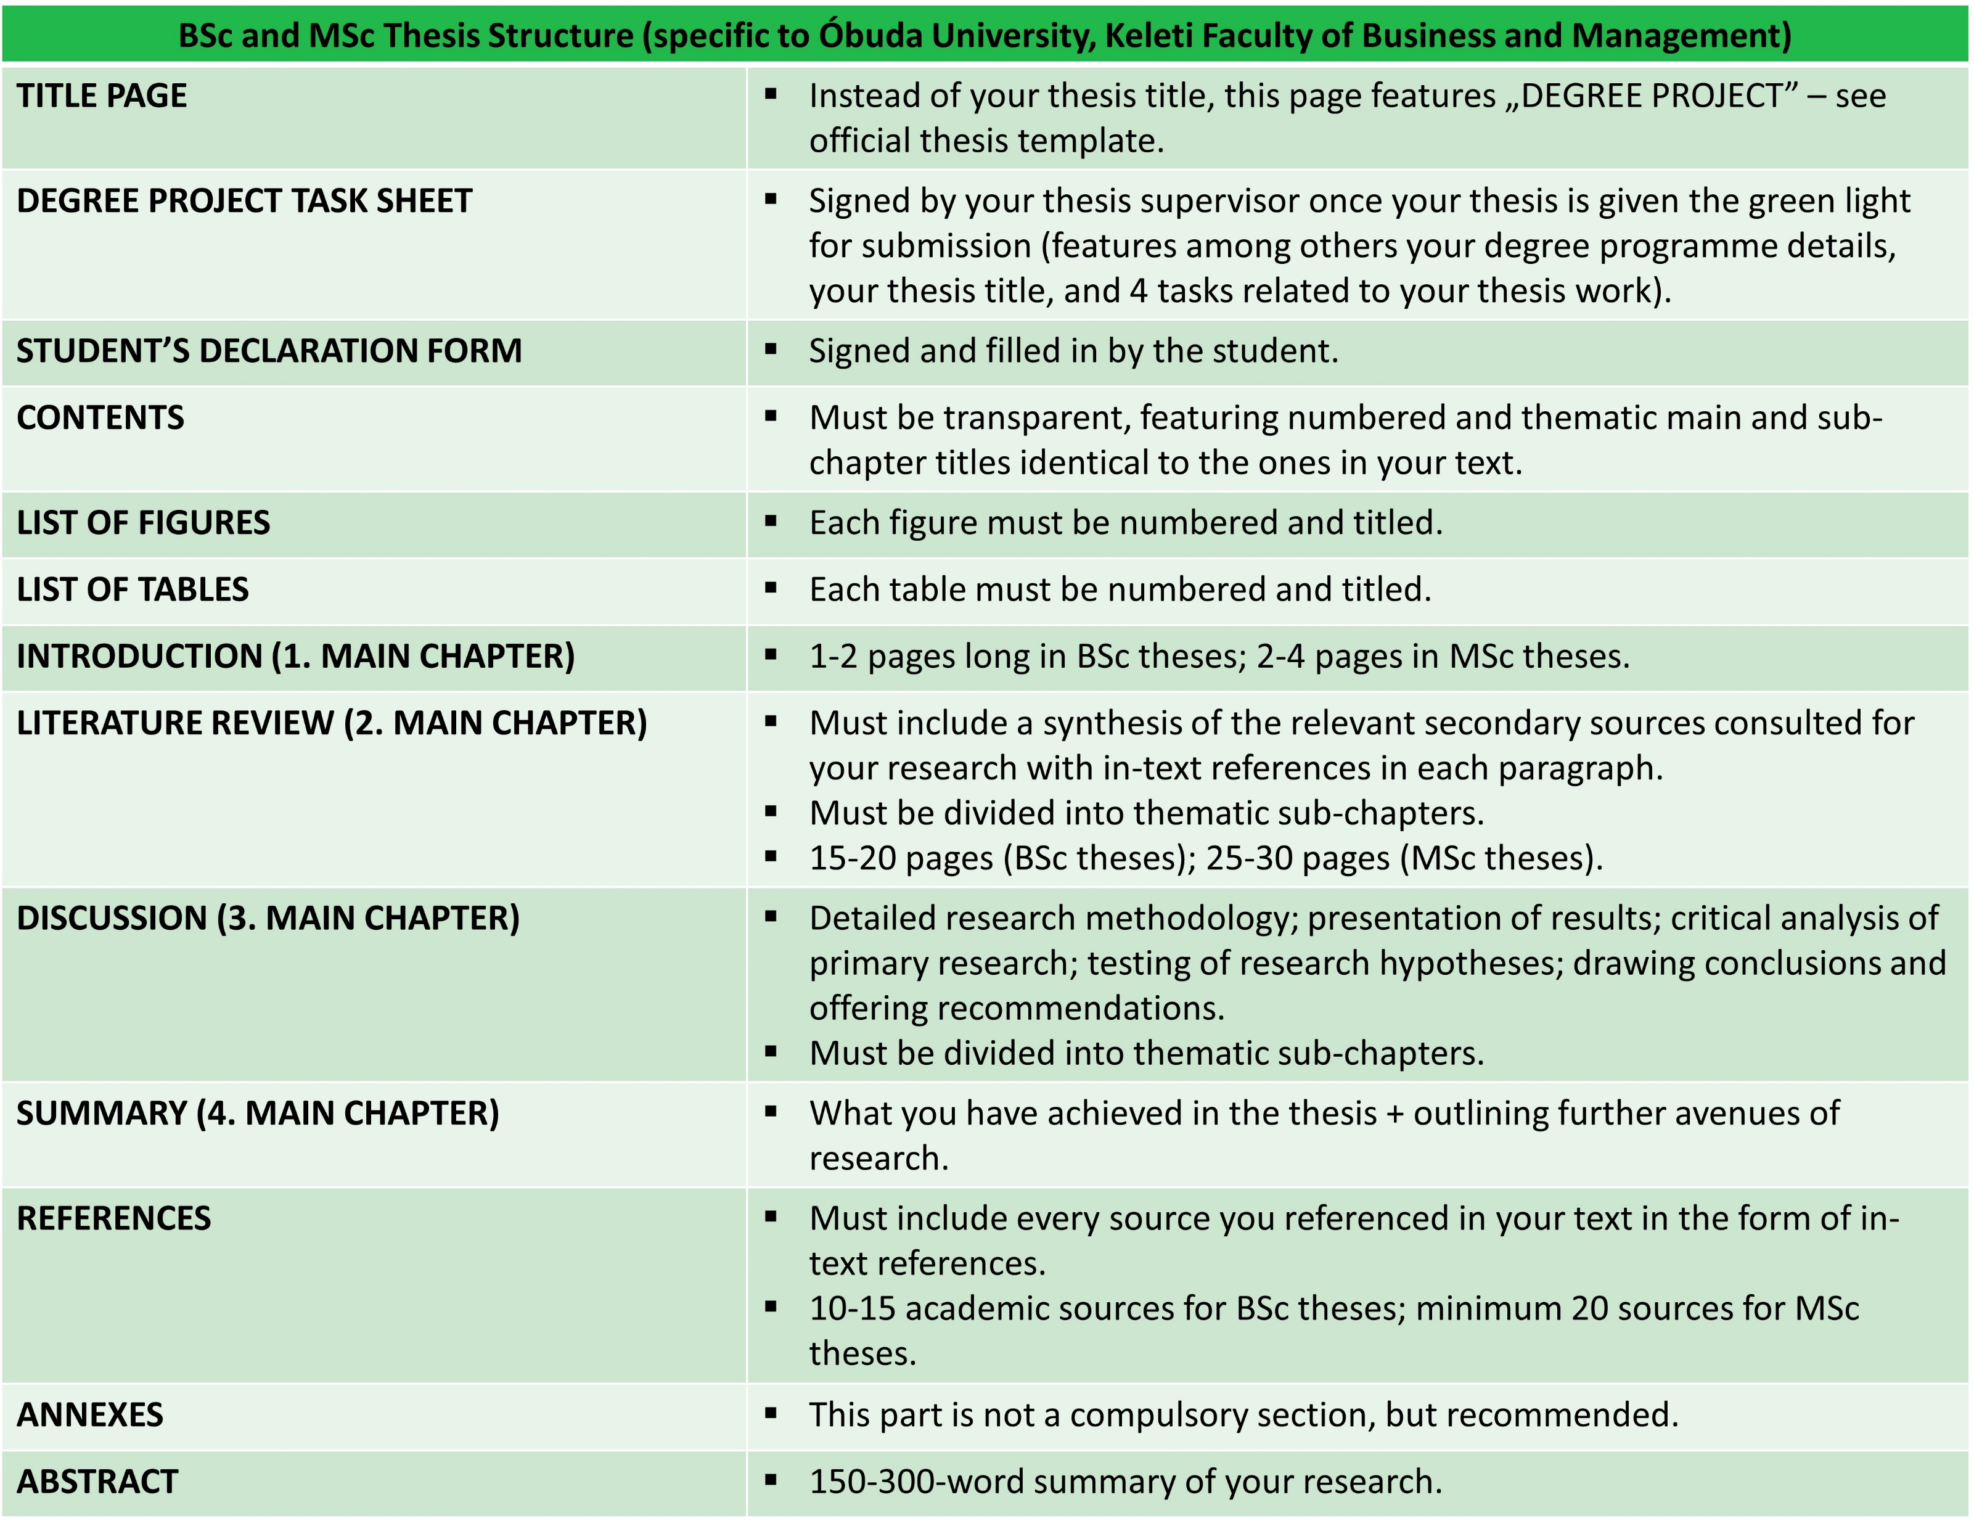
Source: own table

Slide 10
Presenting the Views of Others in your Literature Review
Writing research papers entails citing the works of experts and the views of others must be clearly attributed to the author.
Failing to do this is called plagiarism and is a serious breach of academic honesty.
Academic writing is typically based on evidence from sources researched and reported by others, usually experts.
In terms of referencing style, in your thesis, you are required to adhere to the APA style.
Research is classified as primary or secondary research depending on the source of the data.
  Primary sources are those reported by the writer who conducted the research (through various types of surveys and interviews, for instance).
  Secondary sources are those conducted by others but reported by the writer (literature/scholarship on the chosen topic).

Slide 11
Aim of the Literature Review
A literature review is a piece of academic writing demonstrating knowledge and understanding of the academic literature on a specific topic placed in context.
A literature review also includes a critical evaluation of the material; this is why it is called a literature review rather than a literature report.
You are expected to engage and dialogue with your chosen secondary sources – it is not enough to just summarise or describe the content of the sources, your own voice and critical opinion are crucial, too.
When referring to a source in your Literature Review, you can use direct quotations or paraphrases and summaries of sources – these are called in-text citations.

Slide 12
In-text Citation for Short Direct Quotations
Short quotations, fewer than 40 words, are enclosed within double quotations marks.
A parenthetical citation is inserted into the text with the information necessary to identify the source.
There are three main ways that the citation is typically placed in the text:
The author’s name is not mentioned in the text.
The quote is enclosed in quotation marks and followed immediately by a parenthetical citation that includes the author’s last name, the year of publication, and the page number preceded by “p.”
When the parenthetical citation is directly after the quotation, the period is placed after the parenthesis of the citation.
The author often repeated that “the ancient belief that the dream reveals the future is not entirely devoid of truth” (Freud, 1920, p. 89).

Slide 13
In-text Citation for Short Direct Quotations
2. The author’s name introduces the quotation.
The date of publication is placed immediately after the author’s name in parentheses.
The page number is placed at the end of the quotation.
When Freud (1920) claimed that “the ancient belief that the dream reveals the future is not entirely devoid of truth” (p. 89), many people disagreed with him.
3. The author’s name and date introduce the quotation.
Only the page number is required in parentheses to identify the source.
In 1920, Freud claimed that “the ancient belief that the dream reveals the future is not entirely devoid of truth” (p. 89).

Slide 14
In-Text Citation for Long Direct Quotations
The APA guidelines state that quoted material of more than 40 words should be presented in a free-standing block style.
However, the use of block quotations should be minimal since they tend to obscure the voice of the writer and diminish the cohesiveness of the writing.
When using block quotations:
  introduce the quotation with a colon;
  do not use quotation marks;
  begin on a new line;
  indent the text ½ inch (1.27 cm) from the left margin;
  maintain 1,5 spacing of text;
  place the citation in brackets after the final punctuation in the passage.

Slide 15
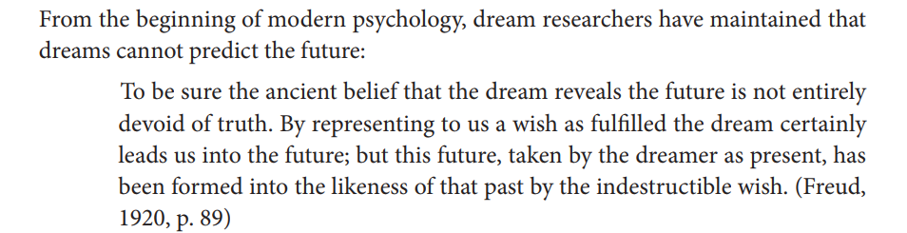
In-Text Citation for Long Direct Quotations
Similar to short quotations, there are two common ways to present block quotations.
1. All of the information (author, date, page number) is placed after the block quotation within parentheses. The period is placed outside of the parenthesis.
(Prinz and Arnbjörnsdottír 2021, p. 168)

Slide 16
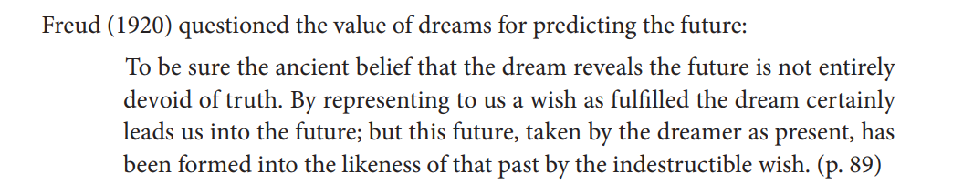
In-Text Citation for Long Direct Quotations
2. When the author’s name introduces the block quotation, the publication date is placed in parenthesis immediately after the author’s name. The page number is indicated in parenthesis at the end of the block quotation.
(Prinz and Arnbjörnsdottír 2021, p. 168)

Slide 17
Paraphrasing a Source
To paraphrase is to reword essential information and ideas expressed by another author.
A paraphrase must be attributed to the original source, too, but when paraphrasing, you do not have to use double quotation marks, and you do not need to indicate the page number in your in-text citation.
A good paraphrase reproduces information from a source by changing both the wording and the sentence structure of the original text:
Original text: “Most, but not all cacti grow in dry climates. For example, the Christmas cactus comes from the rainforest of South America” (Smith, 2020, p. 8).
Paraphrase: While cacti typically require a dry environment, the Christmas cactus originated in the rainforests of South America (Smith, 2020).

Slide 18
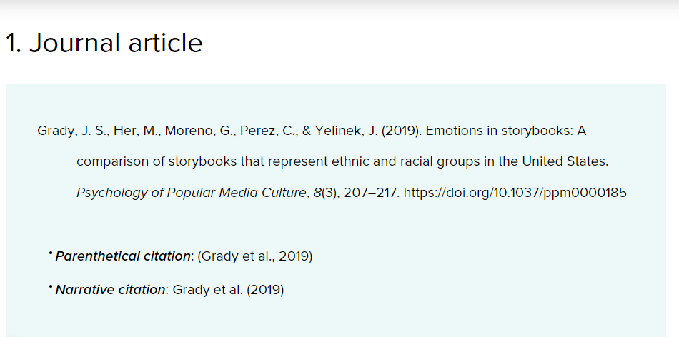
Using APA Style in your Thesis (In-text citations and full bibliographical entries)
Source: APA official website

Slide 19
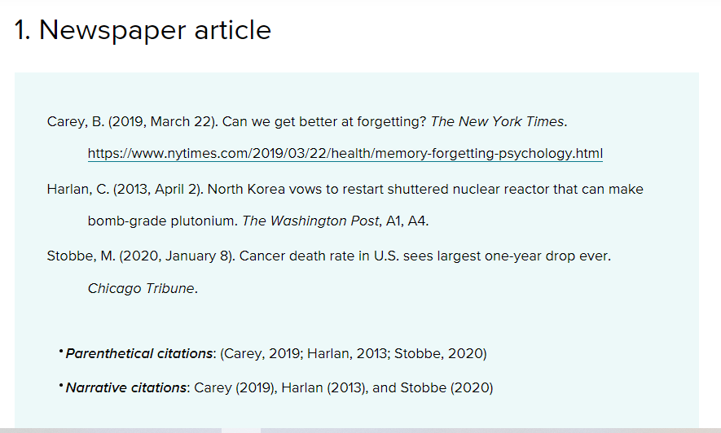
Source: APA official website

Slide 20
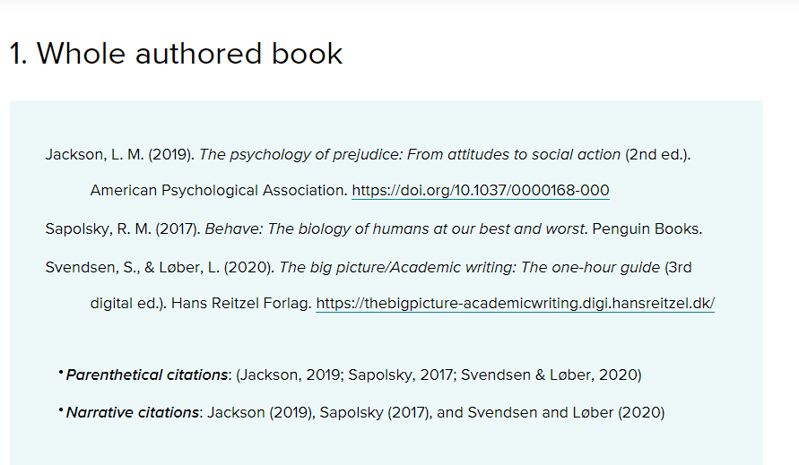
Source: APA official website

Slide 21
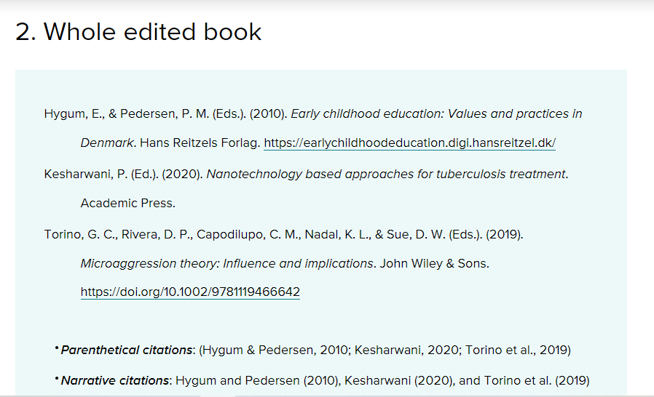
Source: APA official website

Slide 22
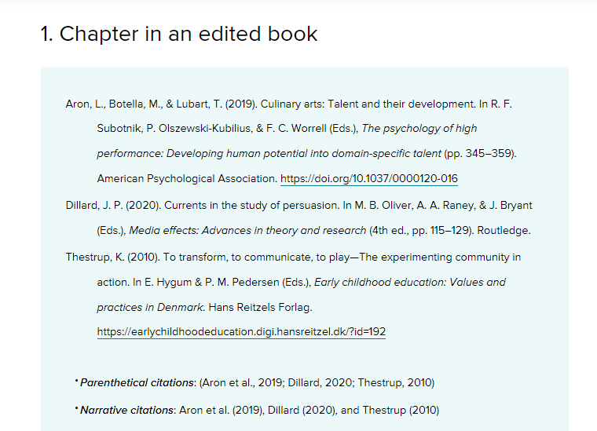
Source: APA official website

Slide 23
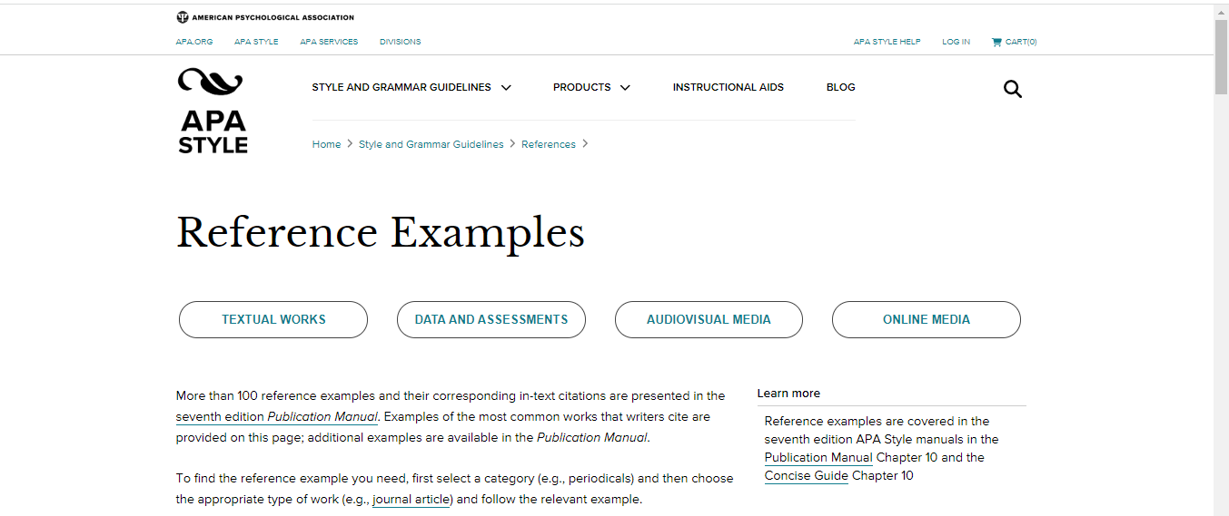
More Information on APA References
https://apastyle.apa.org/style-grammar-guidelines/references/examples

Slide 24
Please pay special attention to the formatting requirements (Title Page, Contents, List of Figures, List of Tables, proper structure with numbered and clearly titled chapters and subchapters, proper text editing, grammar, use of APA-style referencing system for in-text references and the List of References, etc.)
The formatting and proper layout of the thesis is just as important as the content of your thesis!
To make sure that you adhere to the text formatting requirements, you should write your thesis in the English-language thesis template from the very beginning (this will make your and your supervisor’s life much easier).
You can download the Thesis Template from this link (see „Paperformat of the degree project / thesis”: https://kgk.uni-obuda.hu/en/thesis-information-recommended-thesis-topics-by-institutes/official-forms-for-thesis-work/

Slide 25
Open Access Websites and ÓE Library Database to Collect Academic Sources
OAPEN (ONLINE LIBRARY AND PUBLICATION PLATFORM): https://www.oapen.org/
SPRINGER NATURE: https://www.springernature.com/gp/open-science/journals-books/journals
SAGE JOURNALS: https://journals.sagepub.com/home/sgo
LIST OF DATABASES YOU CAN BROWSE WITH YOUR UNIVERSITY ACCOUNT: https://lib.uni-obuda.hu/adatbazisok
Cambridge University Press Journals – https://www.cambridge.org/core
ScienceDirect – https://www.sciencedirect.com/
Statista – https://www.statista.com/
Oxford University Press Journals – https://academic.oup.com/journals
And many more…

Slide 26
Information about the 64th Scientific Students’ Conference (TDK)
The Scientific Students’ Conference, or TDK in Hungarian, is a fantastic opportunity for students in higher education to develop their talents and dive deeper into a scientific topic of their choice.
This involves compiling a paper that may be independent of the thesis, or a preliminary version of it, or the entire thesis itself, and defending it before a professional committee.

Slide 27
Information about the 64th Scientific Students’ Conference (TDK) - DEADLINES
WEDNESAY, 21 OCTOBER 2026, 12.00 (Central European Time): application deadline, including submission of paper title and abstract via the submission portal (https://tdk.kgk.uni-obuda.hu/).
WEDNESDAY, 11 NOVEMBER 2026, 12.00 (Central European Time): submission deadline for the final paper to be uploaded to the submission portal (https://tdk.kgk.uni-obuda.hu/).
WEDNESDAY, 18 NOVEMBER 2026, from 14.00 (Central European Time): 10-minute presentation of your paper in front of a committee and Q&A.
WEDNESDAY, 2 DECEMBER 2026, 17.00 (Central European Time): Award ceremony (Bécsi Street 96/B, Aud. Max.)

Slide 28
The Benefits of TDK
You can develop your professional knowledge and acquire a wide range of important skills through research.
You can have your own mentor who can provide you with professional knowledge and teach you the tricks of the trade necessary for building your career.
You can build valuable professional connections with renowned educators, researchers, and like-minded students.
You can benefit greatly from the evaluation, useful feedback, and constructive criticism of the professional jury.
You can gain recognition and even win awards for your outstanding work.
The skills you acquire and the results you achieve will give you a better chance in the job market or in further education.
Your research can also serve as the basis for your thesis or doctoral dissertation, which can significantly contribute to your future success.
You can collect unforgettable experiences by just participating in the TDK conference.

Slide 29
The Benefits of TDK
If the TDK thesis is ranked (1st-3rd place or special prize) on the institutional event, it can be considered as a thesis and does not need to be defended during the final exam.
It automatically receives an excellent (5) grade.
Outstanding essays may also be nominated for the national event, OTDK (held every two years), where there is an opportunity to gain further experience and achieve success.

Slide 30
Useful Links
Official forms for thesis work: https://kgk.uni-obuda.hu/en/thesis-information-recommended-thesis-topics-by-institutes/official-forms-for-thesis-work/
Thesis submission portal: https://diploma.uni-obuda.hu/
Library databases (to collect and consult academic sources for your research): https://lib.uni-obuda.hu/adatbazisok
Scientific Students’ Conference (TDK) portal: https://tdk.kgk.uni-obuda.hu/index.php

Slide 31
Q&A
Please feel free to ask any questions regarding thesis writing and submission or the Scientific Students’ Conference!

Slide 32
Thank you for your time and attention!

